Slide 1
INTRODUCTION
Fasteats – delivery app for food ordering
Strategy - marketing analysis for customers behavior Business – Engagement results in profit
Solution - Customer profiles optimizing response rates

Slide 2
Business Problem
Analysing customer engagement categories through the sample data and extrapolating for future campaign strategy to maximize profits through better response rate.

Slide 3
Purpose
We have around 500,000 customers and from the given sample of 1793 customer data we see that the number of customers that have accepted the 6th campaign is
267. It means the response rate is 267/1793 ≈ 15%
As per the available data it generated $15,000. It means generating $15,000 generated 15% of the acceptance to the campaign 6 after $26000 spent.
To atleast reach break even, we need 11% more response (11+15=26)!

Slide 4
Raw Data
No of observations – 1792
Predictor variables – 26
Response variable – 1
Discrete Numerical – 17
Categorical – 2
Dummies – 7
Date - 1

Slide 5
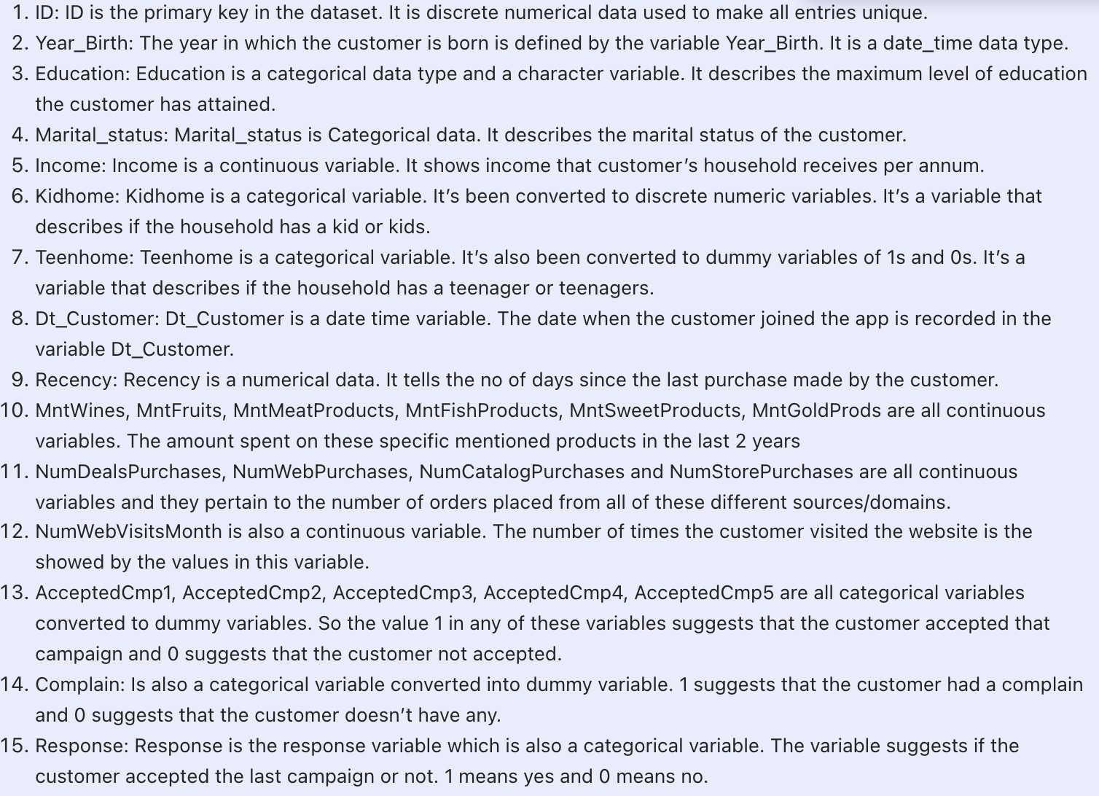
Variables Info

Slide 6
Exploratory Data Analysis

Slide 7
Missing Values | Outliers | Inconsistencies
15 in Income variable | Outliers in all categories of food but most in MntMeat | ‘OPEN’ in Marital status
 | Outliers in some sources of purchase but mostly in Deals | Typos in Year_Birth
 | We would choose to account for them as they are all on the positive side. | Majority ‘Graduates’ in Education Majority couples in Marital_status Majority Wines in Spending
 |  | Cyclic variations in Dt_Customer

Slide 8
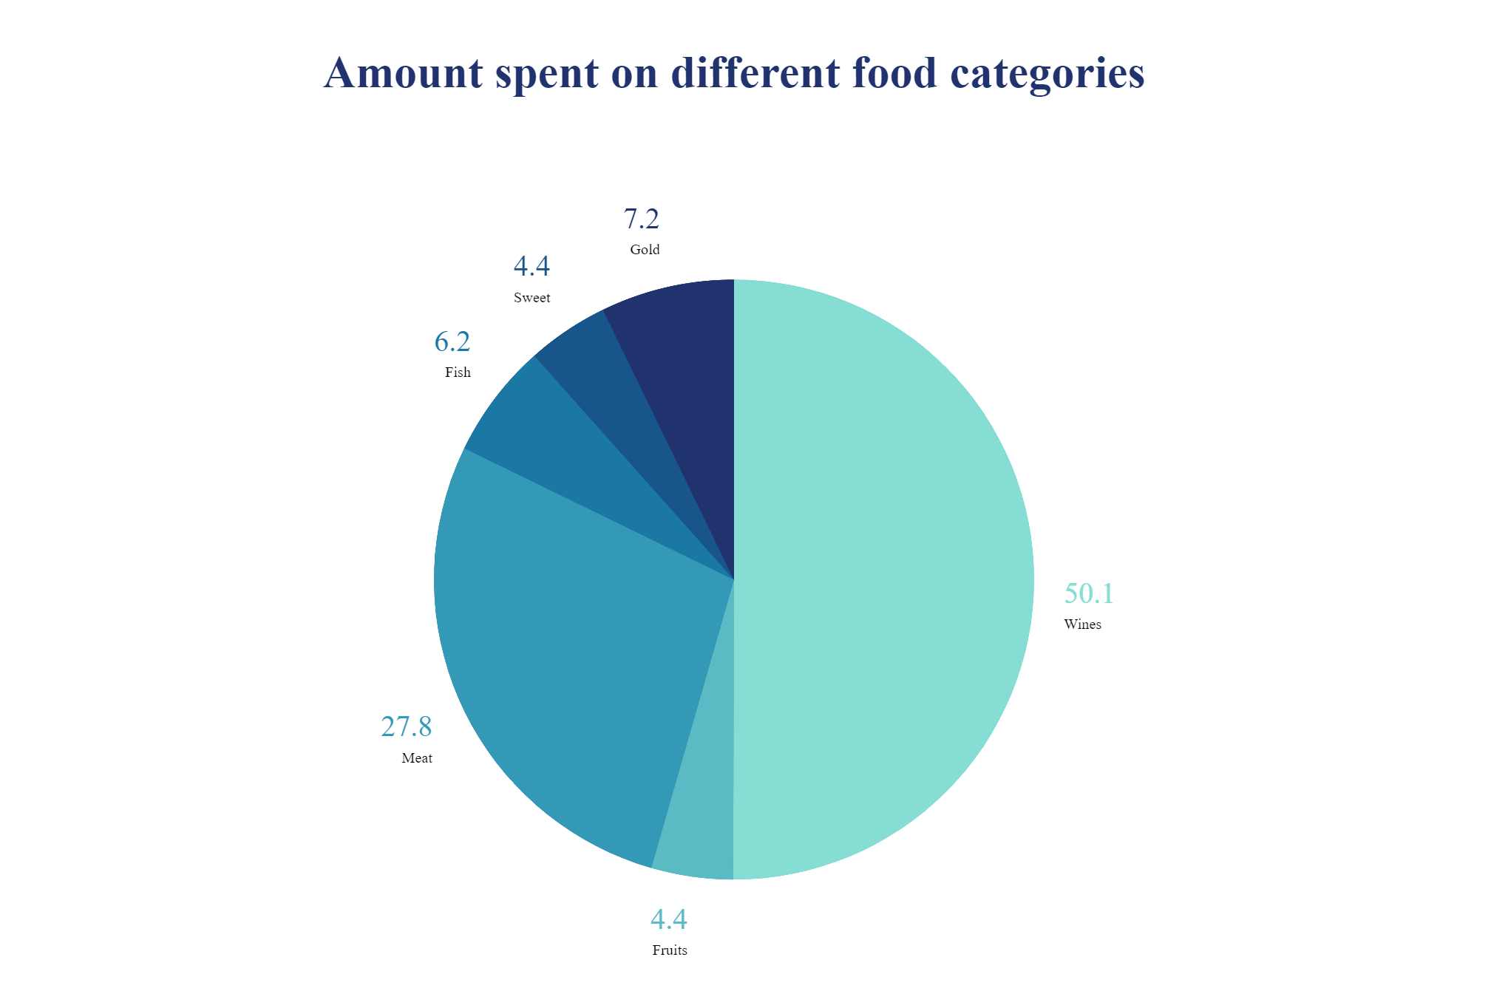
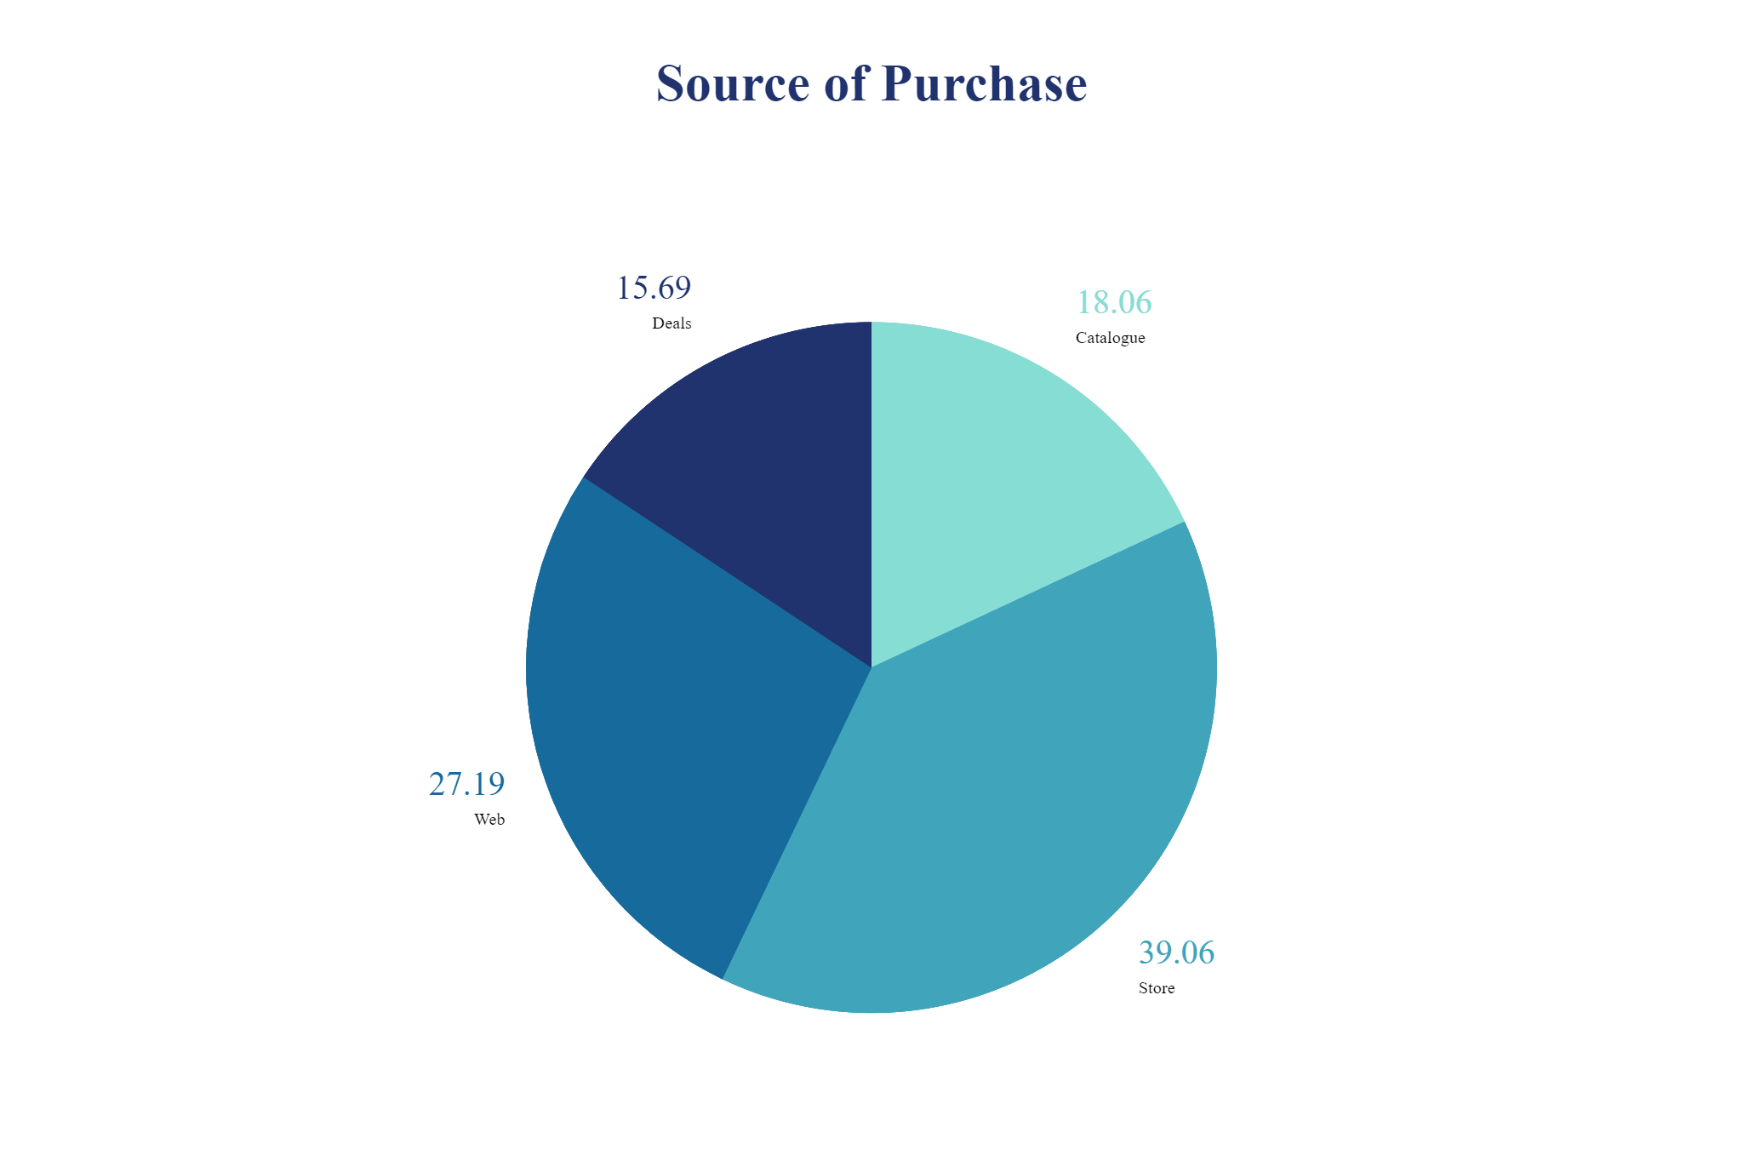
Pie Charts of Spending & Purchase

Slide 9
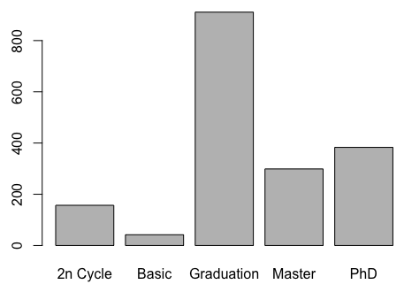
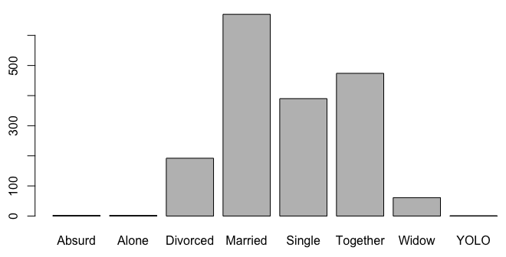
Education vs Marital Status Frequencies

Slide 10
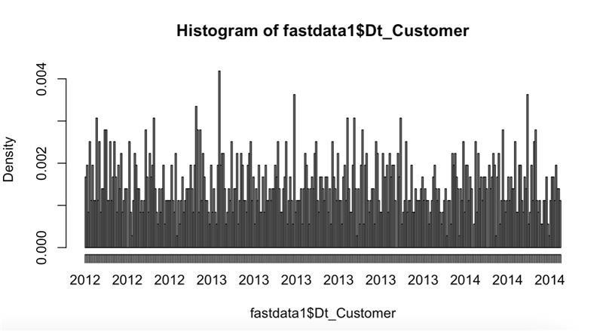
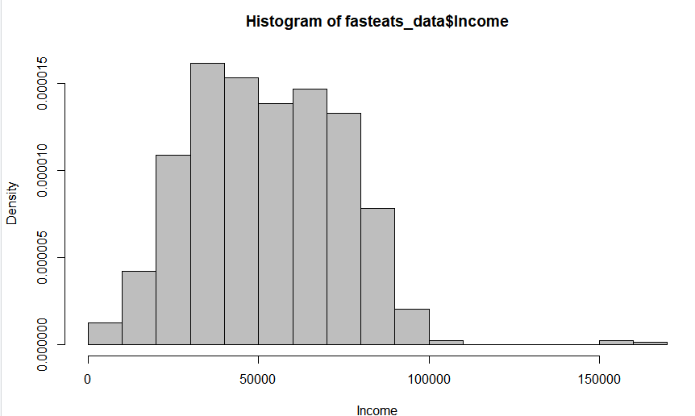
Exploring the Numeric and Date variables

Slide 11
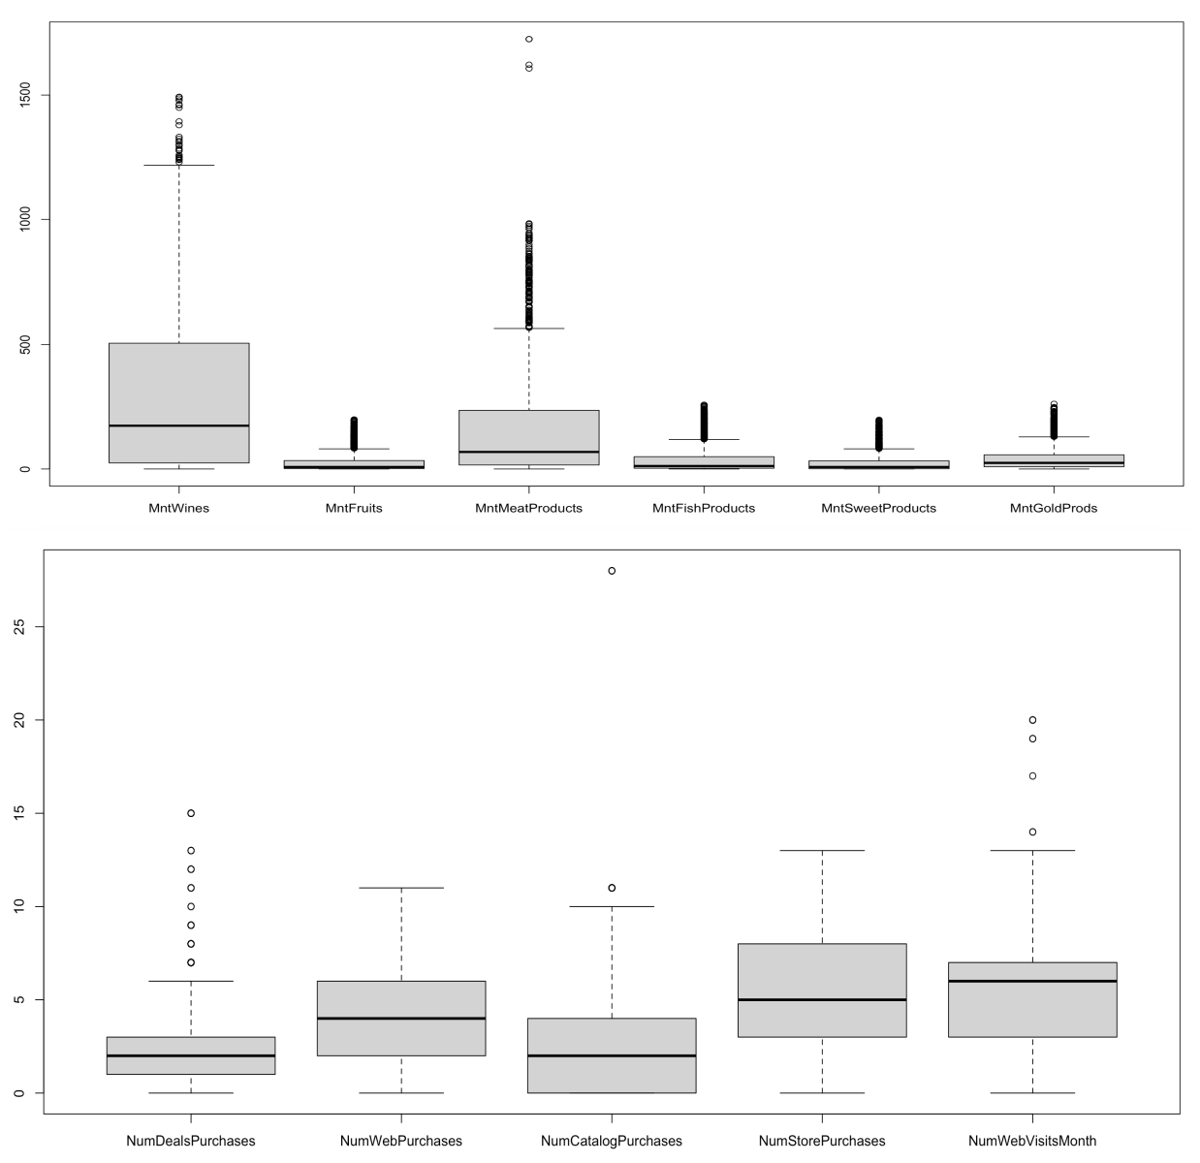
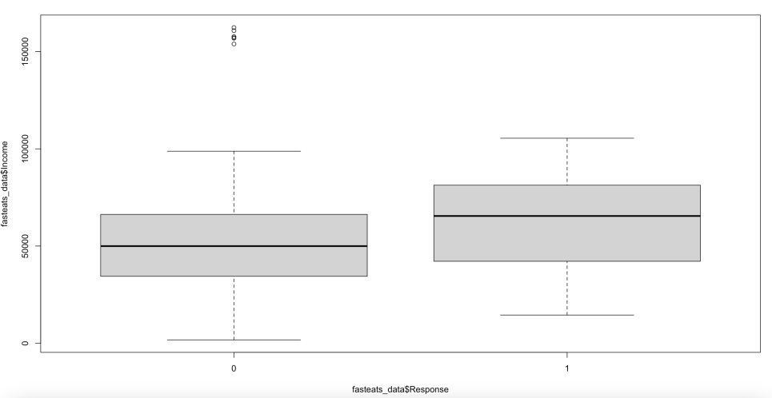
Outliers

Slide 12
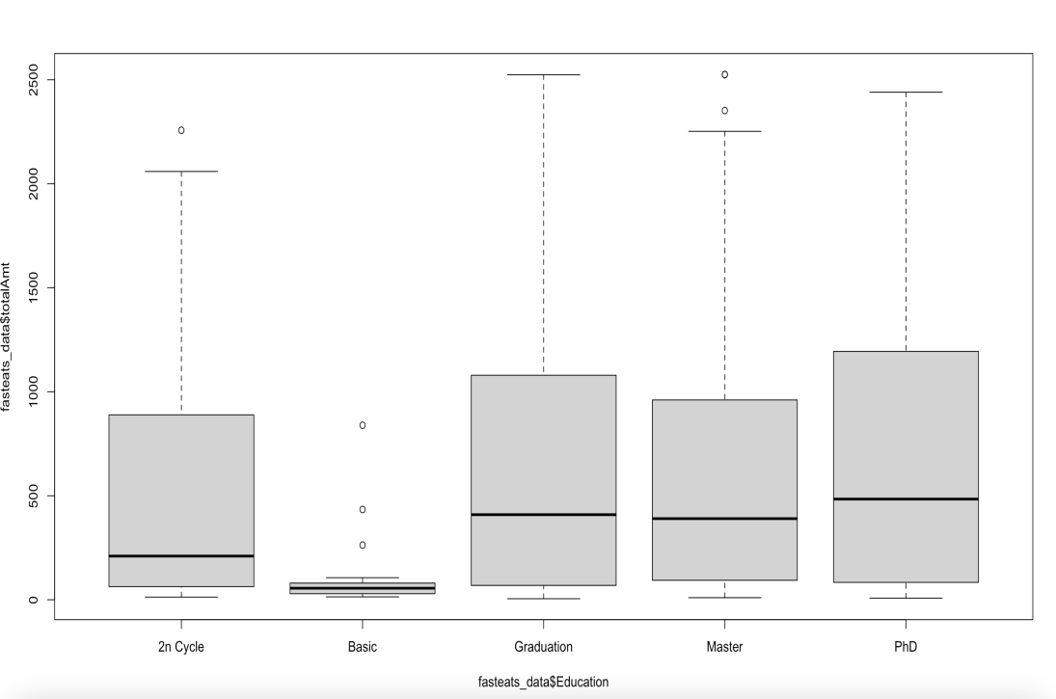
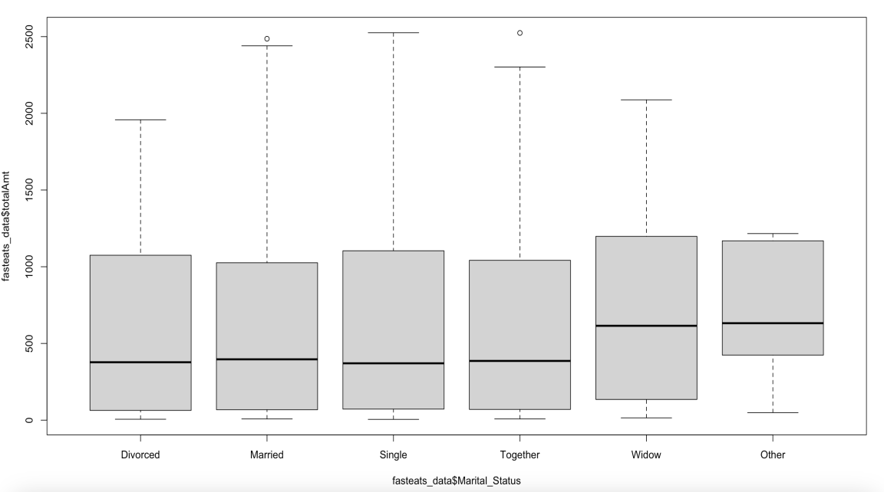
Spends Correlations

Slide 13
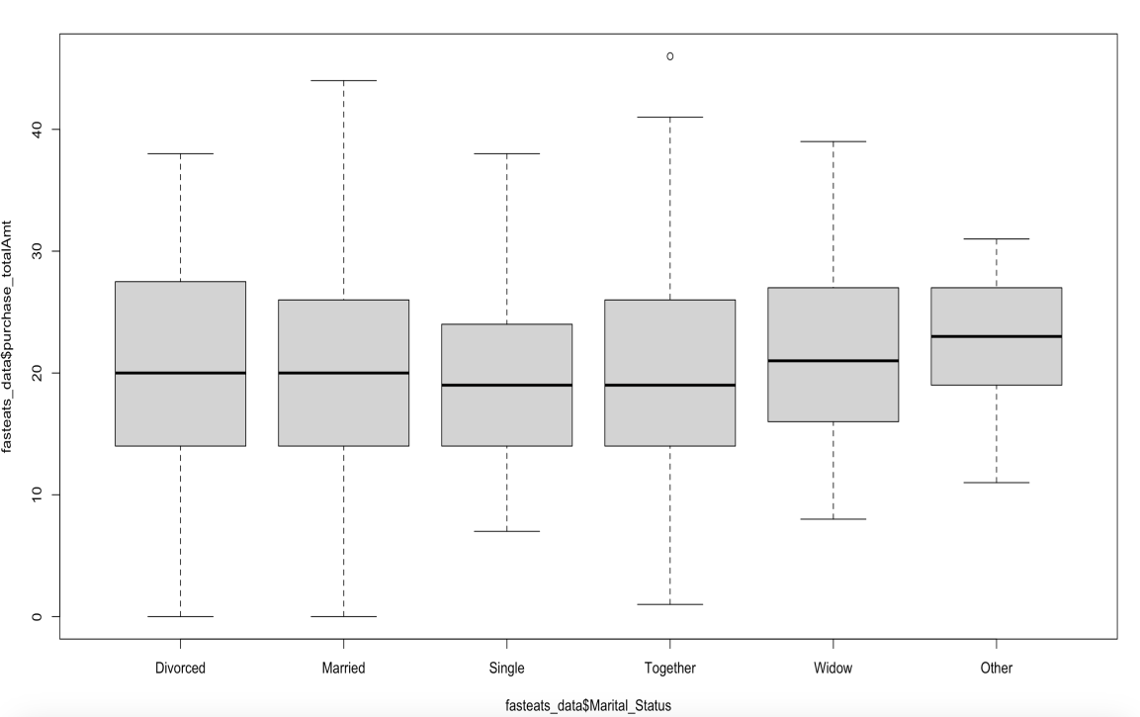
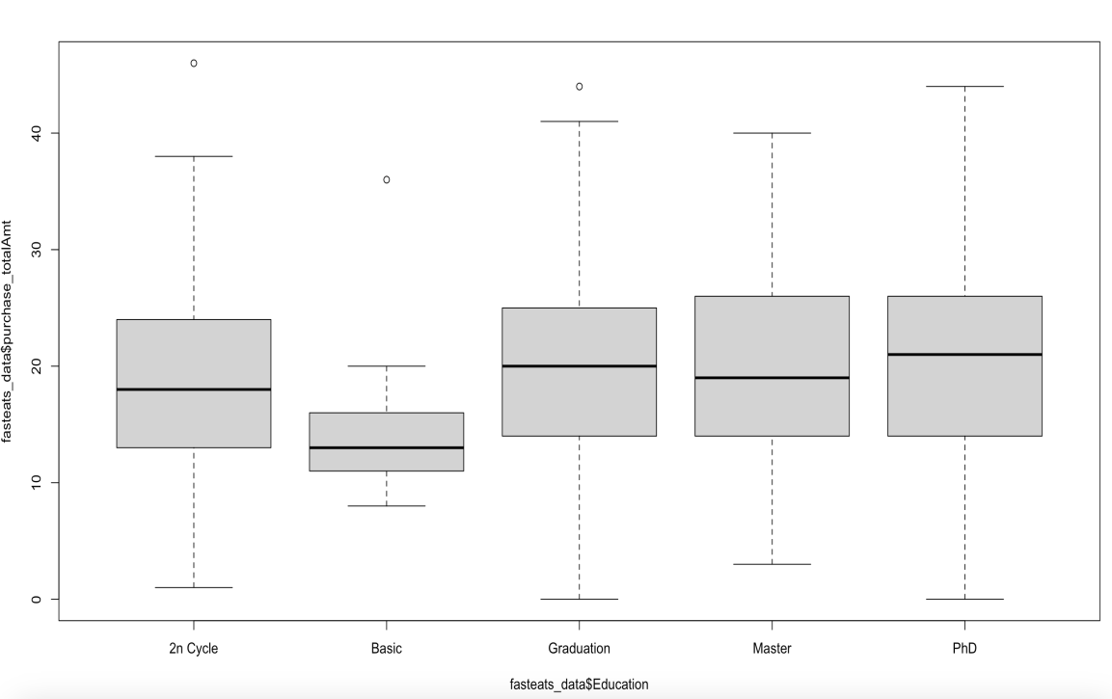
Purchases Correlations

Slide 14
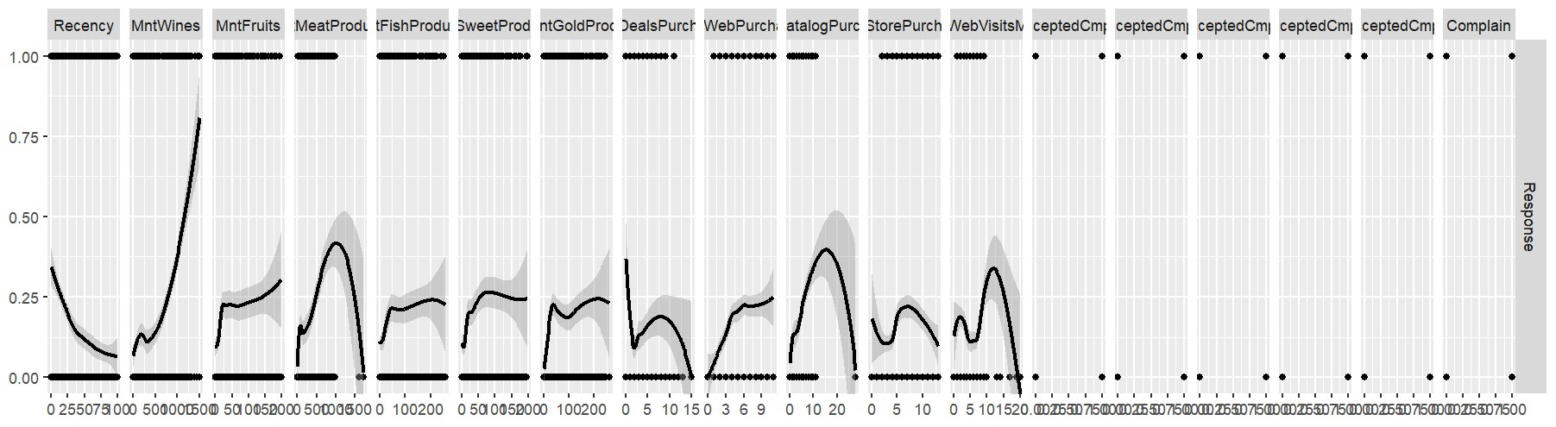
Summation Scatterplots across Variables

Slide 15
Dividing the variables into 5 broad categories
Demographic – Age, Marital status, Education, Children
Customer Data – Recency, Income, Website visits Spending – Wines, Meat, Gold, Fish, Sweet, Fruit Purchase – Store, Web, Catalog, Deals Interaction – Campaign1, 2, 3, 4, 5, Complaint

Slide 16
Feature Engineering
Imputed Median in the Income variable missing values
Merged the categories Alone and Single, Yolo and Absurd into Other
Imputed Year_Birth with median year for syntax error and created Age variable.
ID column has no relative meaning so did not include in the model.
DT_Cust was spanned across two fiscal years and we divided them into 8 quarters to account for the cyclic variations.
We converted amount spent by each customer (Row wise) into its own category percentage and did the same with purchases made in category for clearer analysis

Slide 17
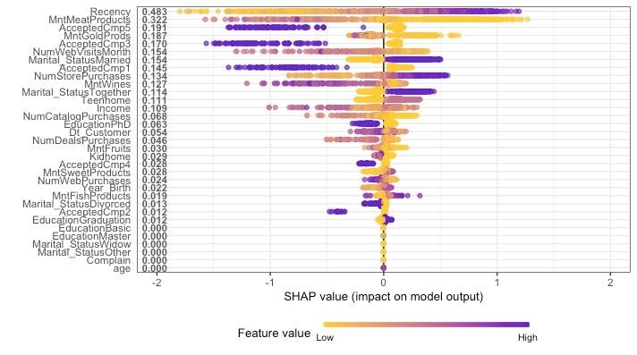
Studying Campaigns Vs Response

Slide 18
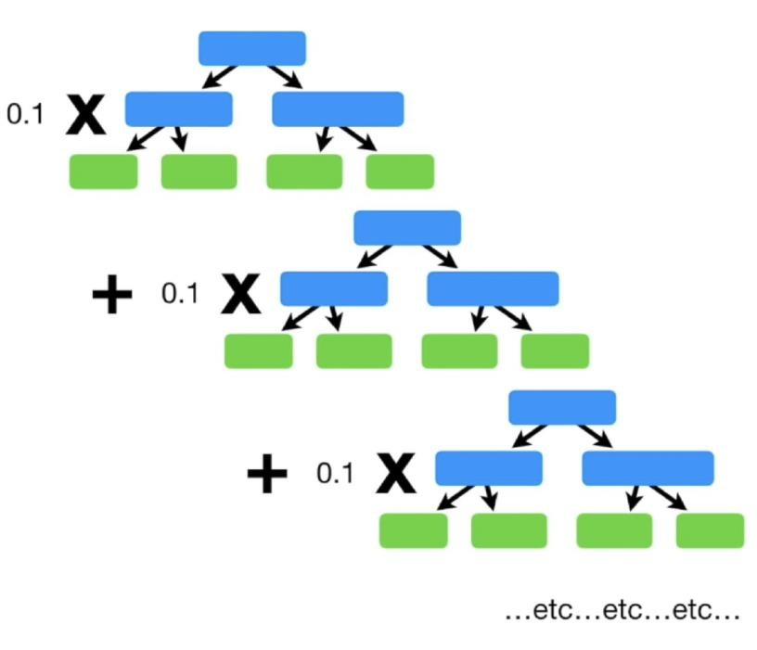
Model Choice - XGBoost
We considered 4 models in total and then finalized on XGBoost as XGBoost has the best prediction accuracy.
XGboost Model gave an AUC of 88.63. Decision Tree gave an AUC of 87.75 Subsetting Model gave an AUC of 89.56 Lasso Model gave an AUC of 89.61
Random Forest Model gave an AUC of 89.57
Though the AUC of XGBoost Model gave a lesser AUC comparatively, because of its prediction accuracy XGBoost Model was selected as the final model.

Slide 19
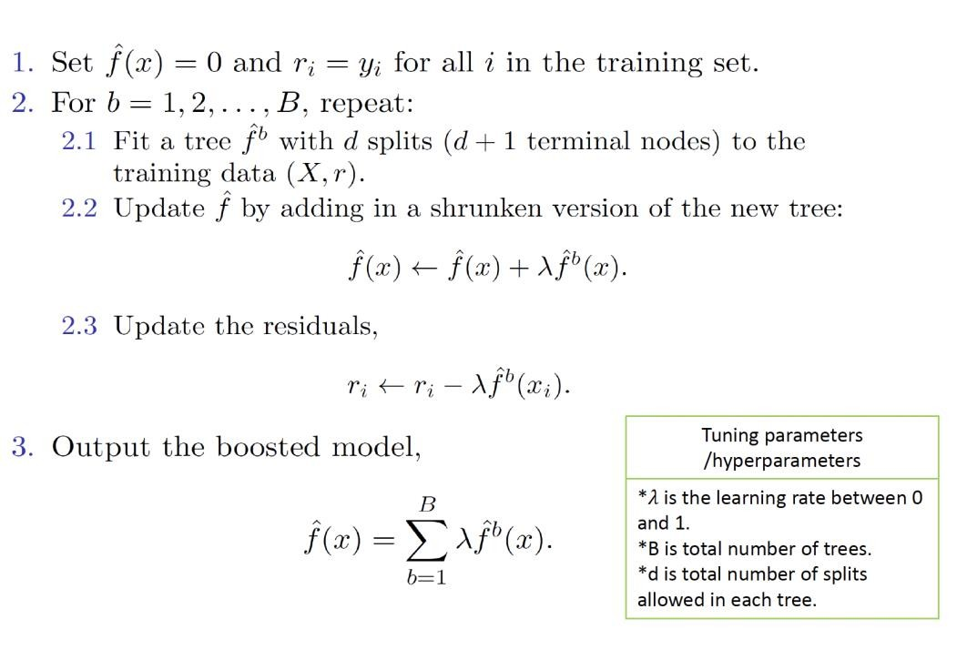
XGBoost Inner Working
XGBoost creates multiple trees created sequentially and we add them up in the end with a learning rate.

Slide 20
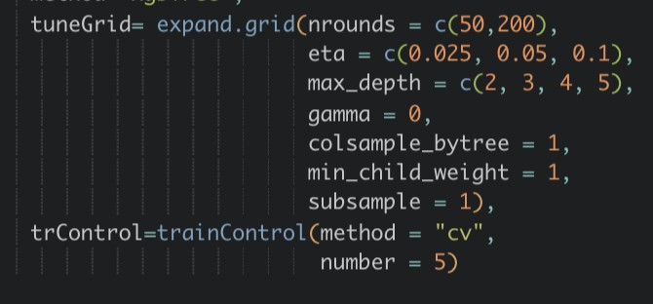
Tuning parameter
nrounds[default=100] - It controls the maximum number of
iterations. For classification.
eta[default=0.3][range: (0,1)] - It controls the learning rate, i.e., the rate at which our model learns patterns in data.
gamma[default=0][range: (0,Inf)] - It controls regularization (or prevents overfitting). The optimal value of gamma depends on the data set and other parameter values.
max_depth[default=6][range: (0,Inf)] - It controls the depth of the tree. Larger the depth, more complex the model; higher chances of overfitting.
subsample[default=1][range: (0,1)] - It controls the number of samples (observations) supplied to a tree. o Typically, its values lie between (0.5-0.8) 7.
colsample_bytree[default=1][range: (0,1)] - It control the number of features (variables) supplied to a tree o Typically, its values lie between (0.5,0.9)

Slide 21
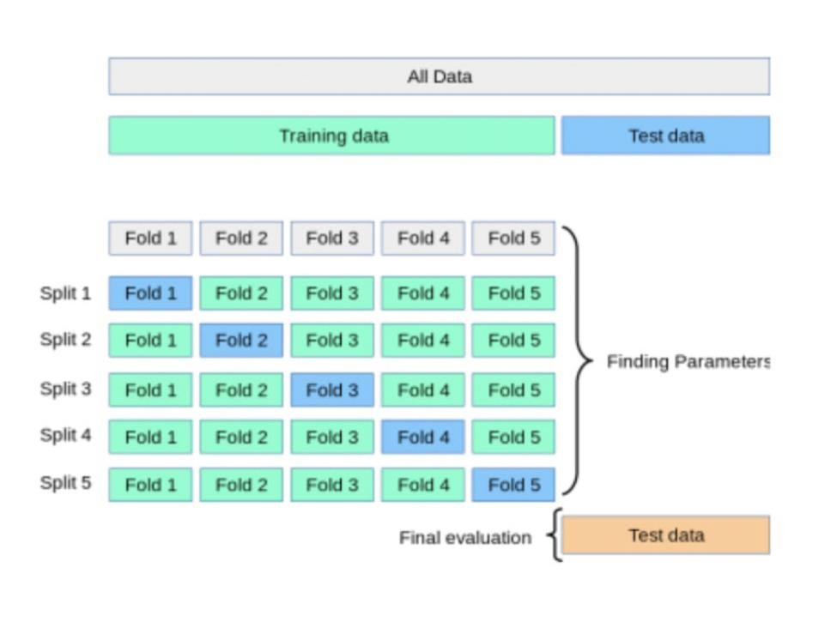
K fold cross validation
We used 5 – Fold Cross Validation to Training Dataset over 5 different divisions of validation sets to finally test on the test set.

Slide 22
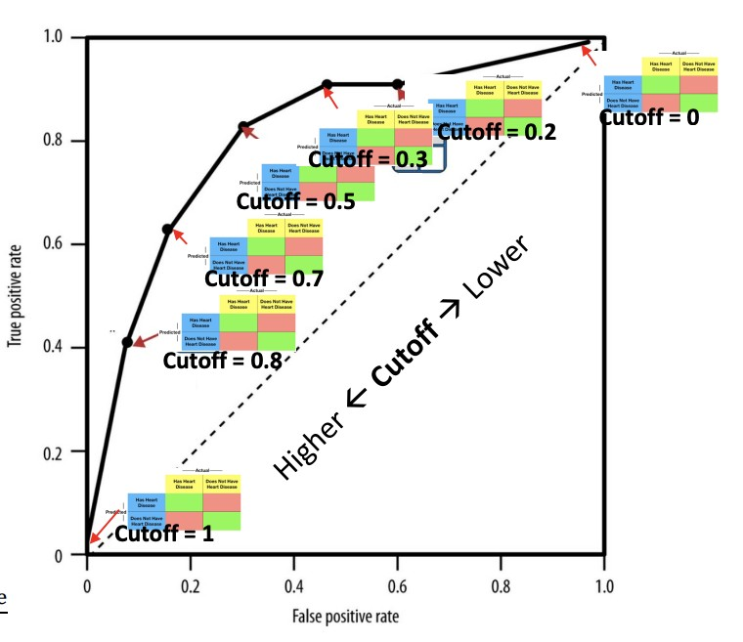
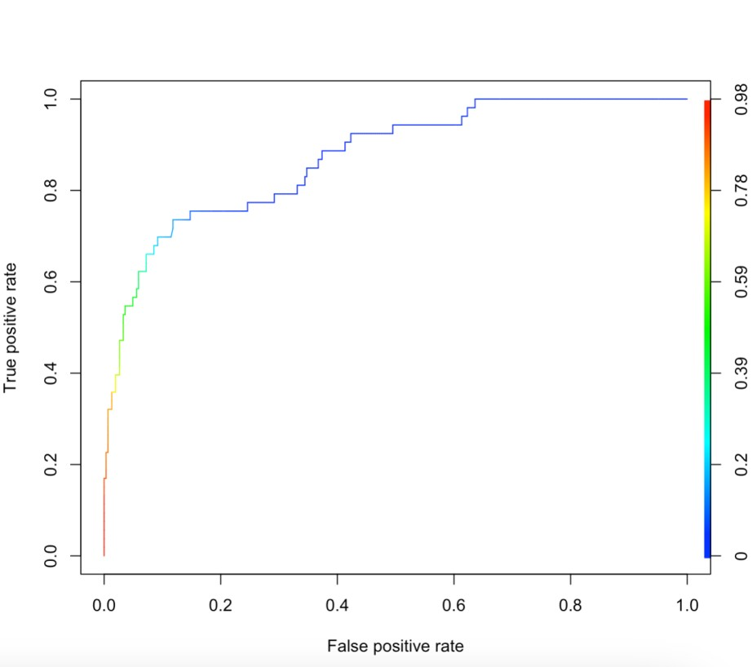
Evaluation Metrics
AUC - 88.63

Slide 23
Generalization | Bias and Variation Trade off
For any model we need an approach that can evaluate how the model generalizes to new Data.
Overfitting: Overfitting occurs when a flexible model finds a chance or irrelevant occurrences in the data it was built on but does not perform well on new datasets.
To avoid this we divide the dataset, into a training set and a testing set. We build the model based on training set and test the model on testing set. Here we used 80% as training set and 20% as testing set.

Slide 24
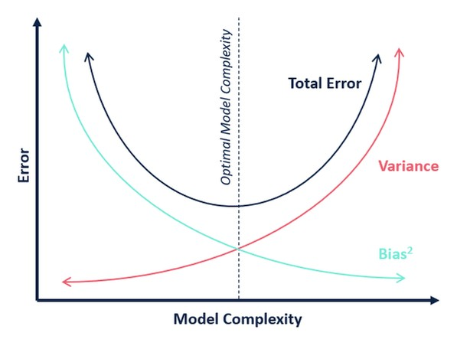
Generalization | Bias and Variation Trade off
Bias refers to the error that is introduced by modeling a real-life problem by a much simpler problem. In other words, how well the model fits the data.
The more flexible/complex a method is the less bias
it will generally have.
Variance refers to how much the model and the predictions change if a different training data set it used.
The more flexible a method is the more variance it has.
Best model is the sweet spot of low bias and
relatively low variance.

Slide 25
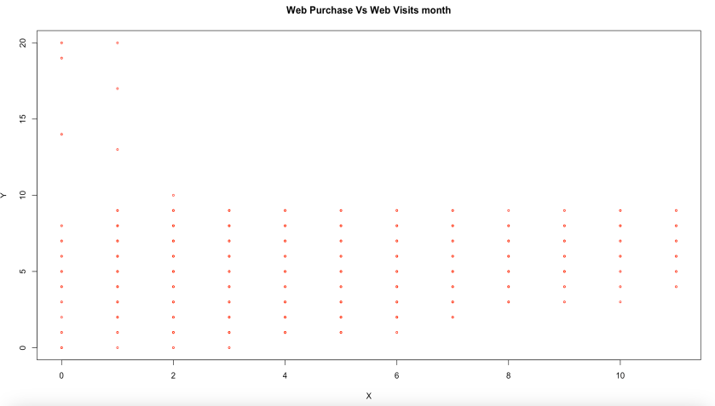
Recommendations
Contact the 17 complaints in the data and do immediate follow-up's with customers as the response rate for this is 5%!
Campaign 2 was the disaster with the response rate of 1% and campaign 6 was the most
successful out of the existing attempts, so this is what we will build up on.
Web visits translate to more web purchases but the visits are themselves quite less on average, hence website needs to be revisited
Put validation filters on entry points for marital status.

Slide 26
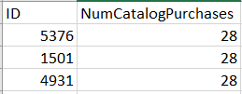
Future Work
Check up on three customers with highest
catalog purchase of 28 but with no response.
New data being less biased on education till graduation, amount spend on wines and couples can be sampled further.
Overall your customers who are the most active are
responding the least.
Total Response | Total Purchases
0 | 17,870
1 | 5023
2 | 2149
3 | 829
4 | 666
5 | 160

Slide 27
Final Insight
Strategy - Direct marketing
Tailored approach
Campaign mix
Method - Reverse Engineer for each campaign along with our Final model

Slide 28
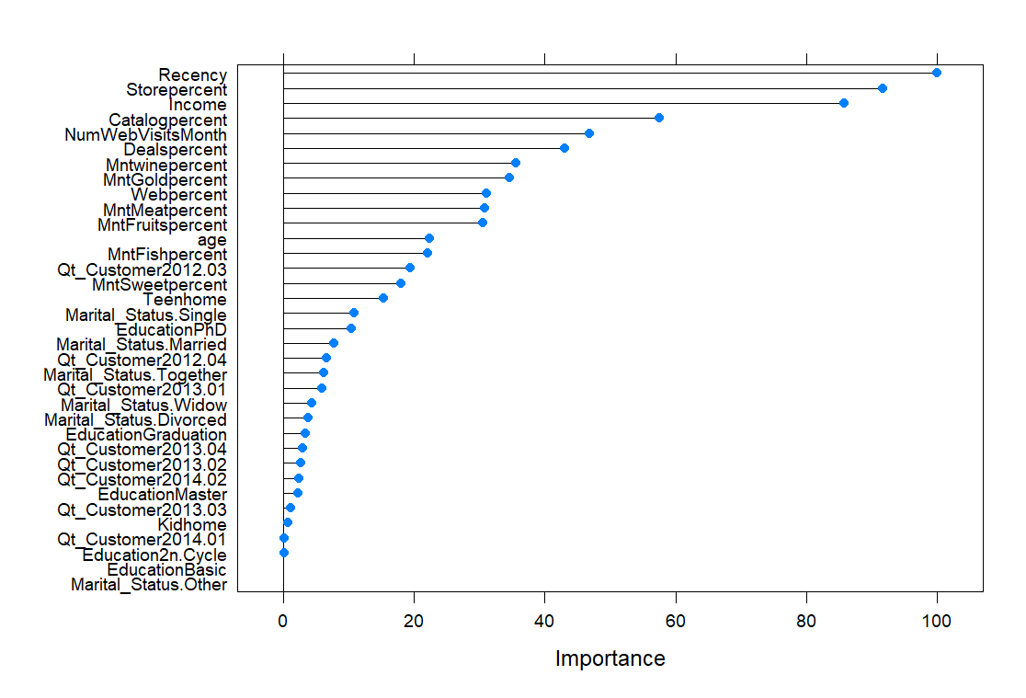
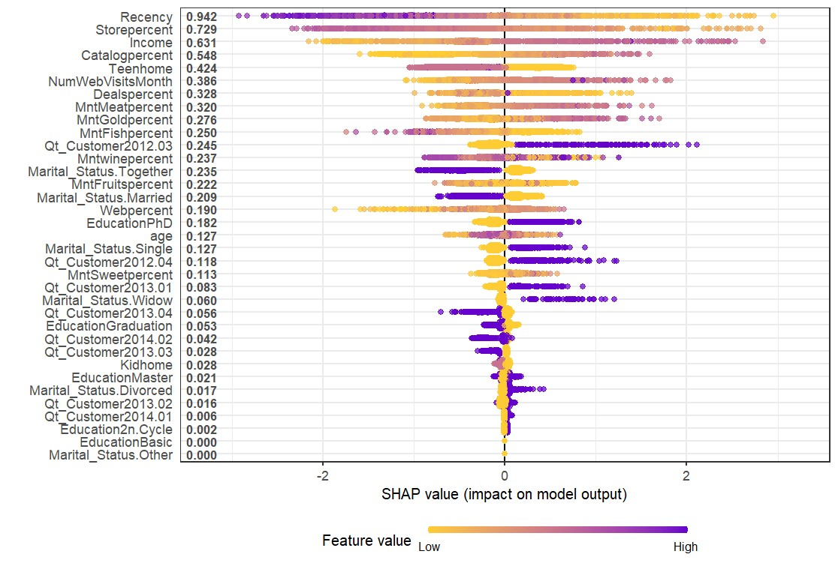
RESPONSE
Profile 6: Young educated singles having high income ordering Meat & Luxuries on Catalog & Web who joined early and are very frequent.

Slide 29
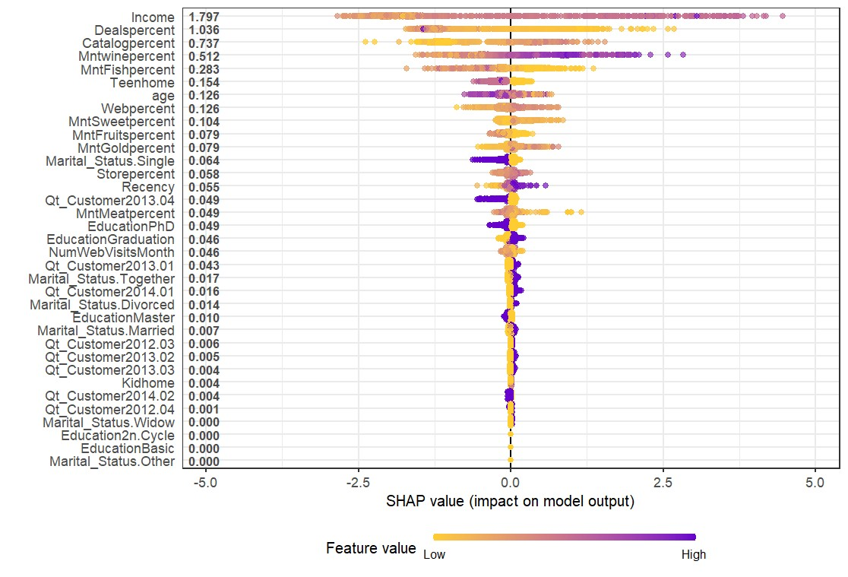
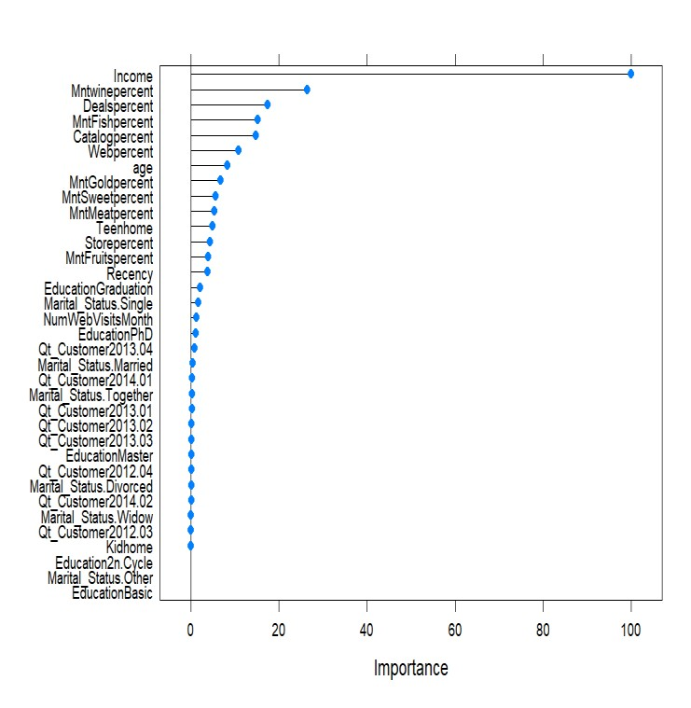
Campaign 5
Selecting All zeros in Campaign 6 and then Modelling for Campaign 5 gives 60 further Yes: Profile 5: Couples mainly ordering on Web for Wines with basic education infrequently.

Slide 30
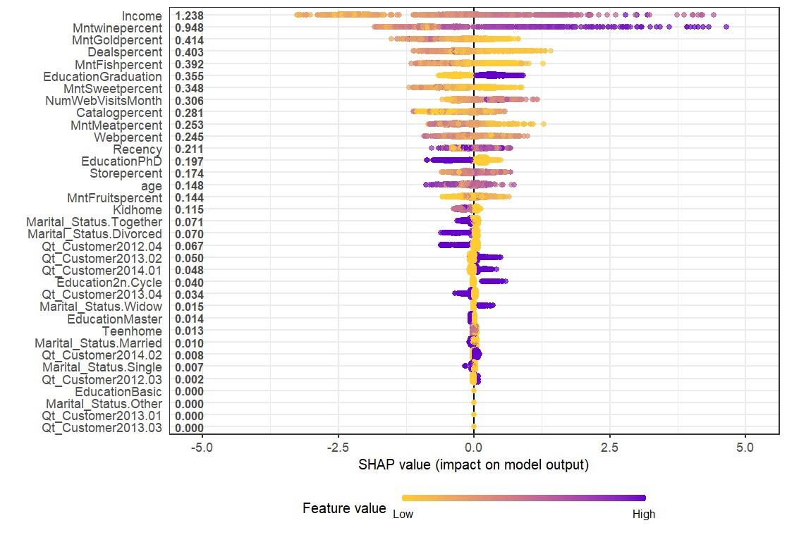
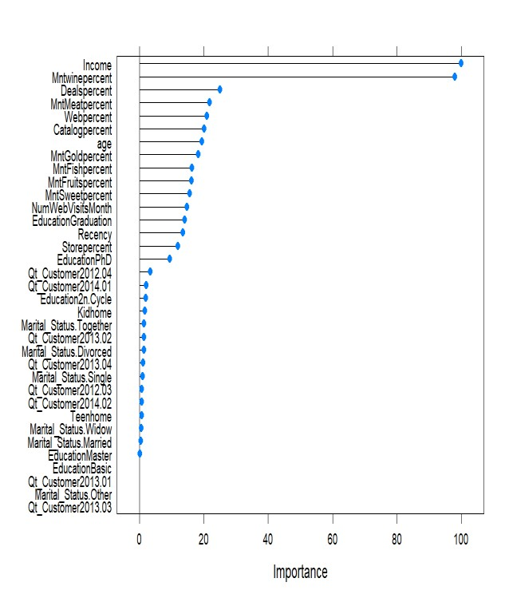
Campaign 4
Selecting All zeros in Campaign 6 and then Modelling for Campaign 4 gives us 81 further Yes, and 67 unique yes over Campaign 5:
Profile 4: Low income and less educated individuals who order basic and join seasonal.

Slide 31
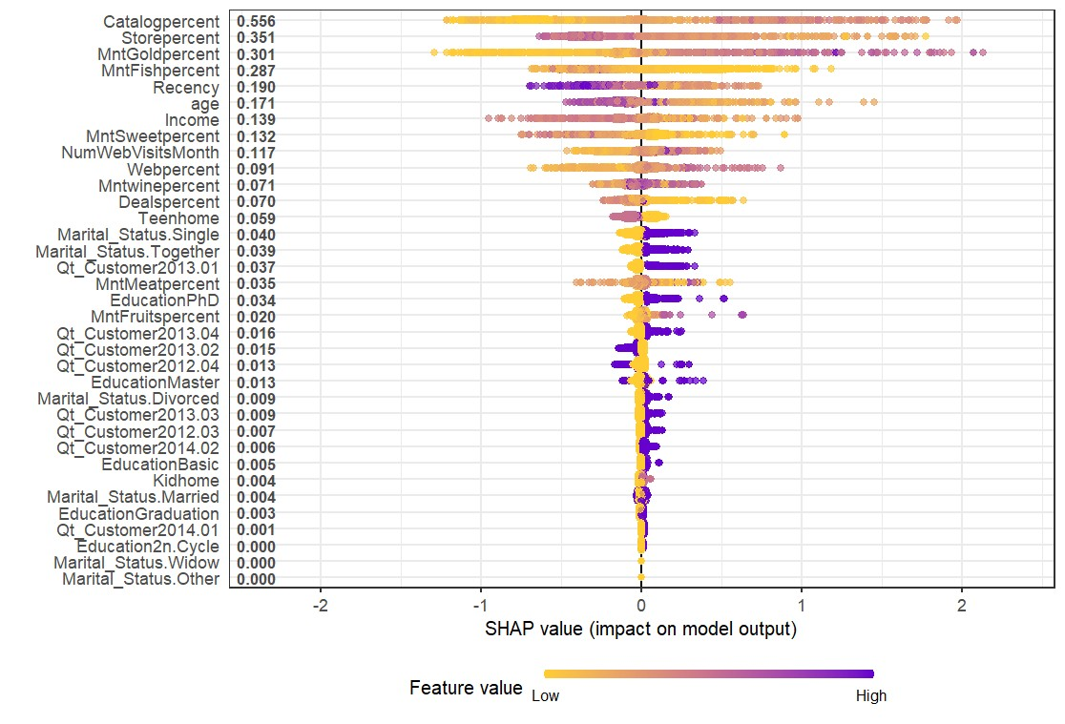
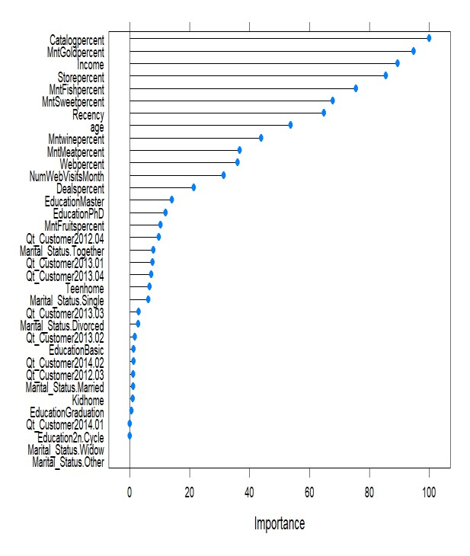
Campaign 3
Selecting All zeros in Campaign 6 and then Modelling for Campaign 3 gives us 63 further Yes, and 57 unique yes over Campaign 4 and Campaign 5:
Profile 3: Late joining, educated couples raising family ordering luxury frequently on both web & catalog.

Slide 32
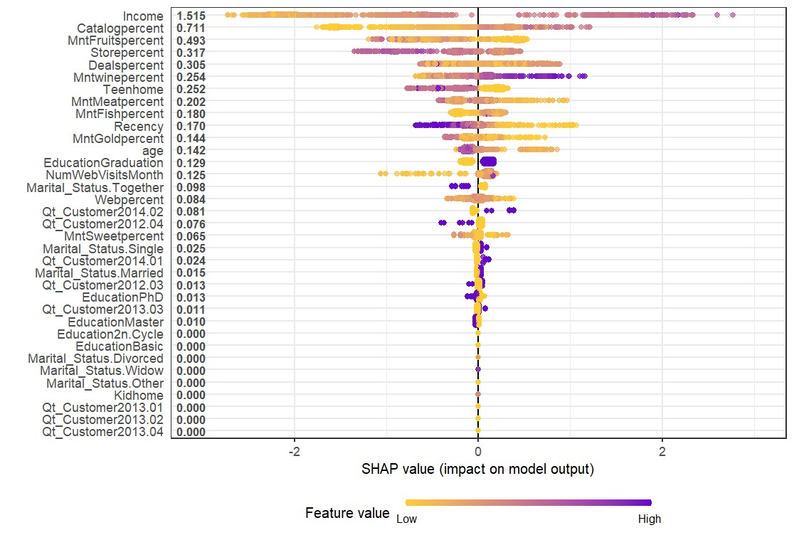
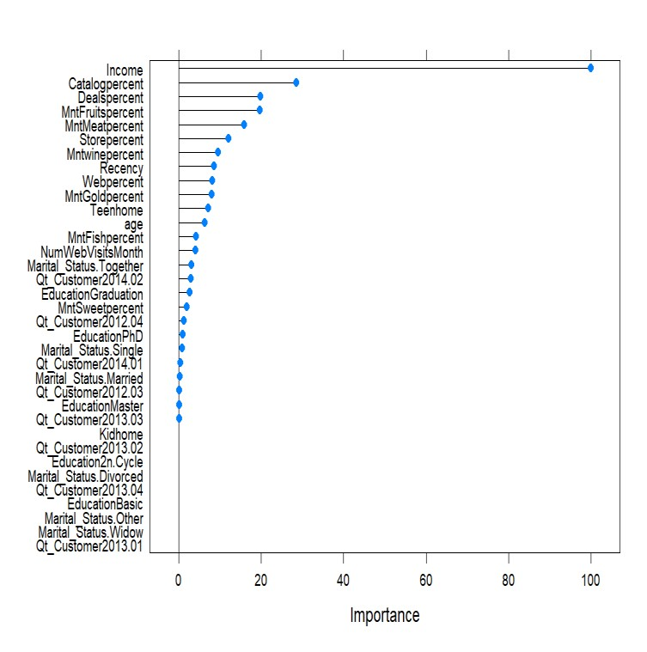
Campaign 1
Selecting All zeros in Campaign 6 and then Modelling for Campaign 1 gives us 54 further Yes, and 33 unique yes over Campaign 3, Campaign 4 and Campaign 5:
Profile 1: Less frequent singles ordering basics on deals due to crunched finances who joined late

Slide 33
Profile 6 | Profile 5 | Profile 4 | Profile 3 | Profile 1
Recent | Non Recent | NA | Recent | Non Recent
Young | Young | Young | Aged | Young
Educated | Less Educated | Less Educated | Educated | Less Educated
Single | Couple | NA | Couple | Single
High Income | High Income | High Income | High Income | High Income
No child | No child | No child | Child | No child
Early | Early | Seasonal | Late | Late
Meat | Wine | Fruit | Gold | Fish
Gold | Sweet | Wine | Wine | Wine
Sweets | Gold | NA | Fruit | NA
Catalogue | Web | Store | Catalogue | Deals
Web | Catalogue | NA | Web | Catalogue

Slide 34
Maximizing Profit thru Direct Marketing
To cover missing categories of importance we propose a campaign designed for Profile 7 in order to capture more:
Profile N: Low income educated families looking to order basic on deals frequently.
Solution:
Low Budget > Tailor each campaign for each Profile
High Budget > Create new campaign with a Mix of all previous ones.

Slide 35
Steps to Result
Step 1: Run the fundamental model on new data for prediction on last response Step 2: No? Run the same model for C5
Step 2: No? Run the same model for C4, C3, C1 in order. Step 3: Run it for the next campaign on Profile N
Step 4: Post maximizing your response rate (profits through engagement) direct market to each Profile.
Result: Existing finding make us capitalize for 267 customers while this process adds up 217 more. Almost double!
217/1792 = 11% Increase in Response Rate
11% converts to 11,000 at least i.e (11,000 + 15,000) = $26000 BREAKEVEN.

